Slide 1
AlphaProphet
מגישים: עומאר אלחסנאת ו עבדאללה אלחמאמדה
מנחה: ד"ר האופטמן עמי

Slide 2
Introduction
Using advanced data analysis to provide insightful predictions on stock prices.

Slide 3
Problem
Complexity of Influences
High Volatility
Market Dynamics

Slide 4
Solution
Generating indicators
Best indicators combinations (XGBoost)
Clustering for stocks by using fundamental data (DBSCAN)
Deep learning to guide to investment choices (SGA)

Slide 5
Indicators
Tools used to analyze past price and volume data to forecast future market movements.
Common indicators:
Simple moving average (SMA)
Weighted moving average (WMA)
Relative strength index (RSI)
Volatility Index (VIX)
Stochastic %K & Stochastic %D
Exponential moving average (EMA)
Moving average convergence/divergence (MACD)

Slide 6

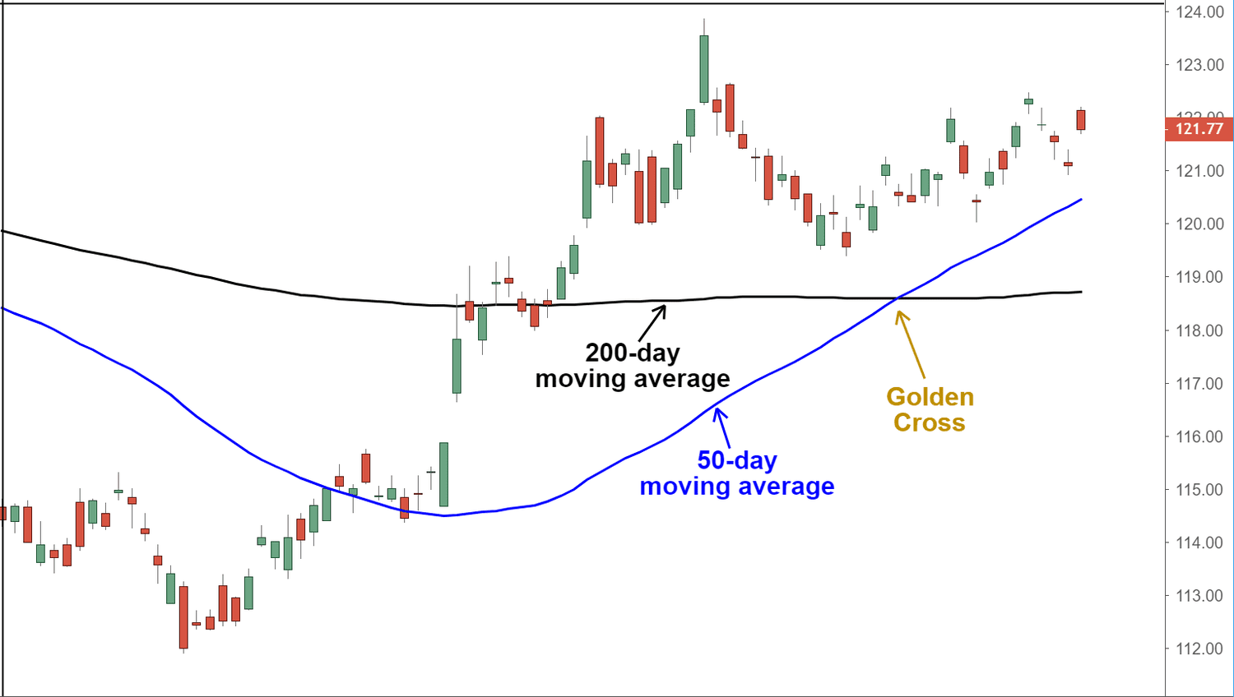
SMA Indicator
SMA calculates average security price over set periods, indicating trends.
Calculation:
Sum the closing prices over the specified periods.
Divide by the number of periods.

Slide 7
XGBoost

Slide 8
DBSCAN

Slide 9
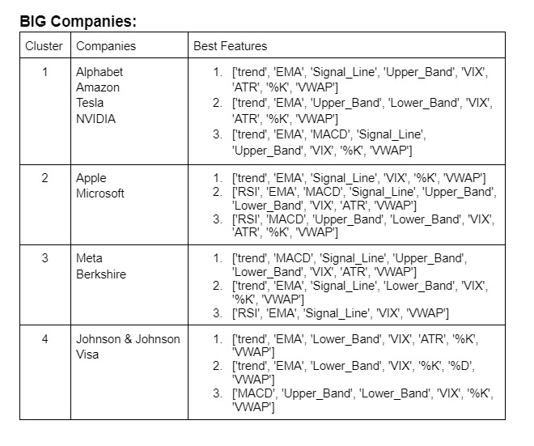
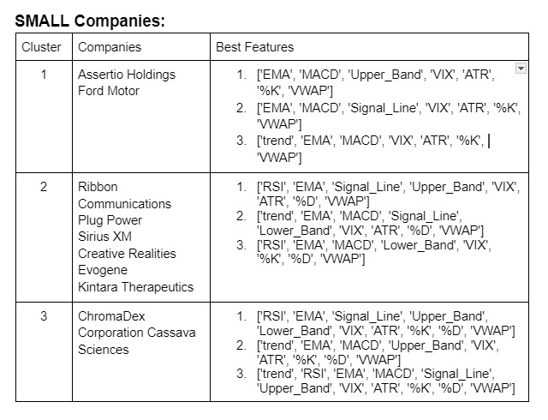
Clustering
Features used for clustering : [ 'marketCap' , 'ebitda' , 'forwardPE’ ]
DBSCAN clustering algorithm

Slide 10
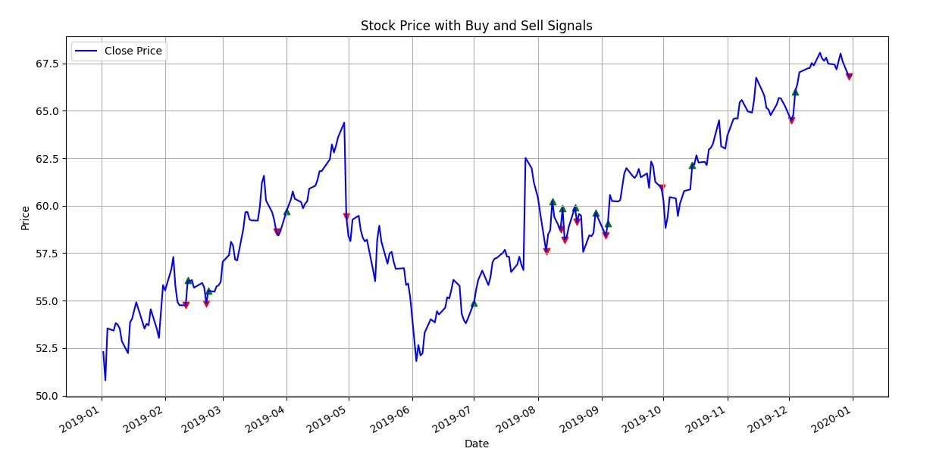
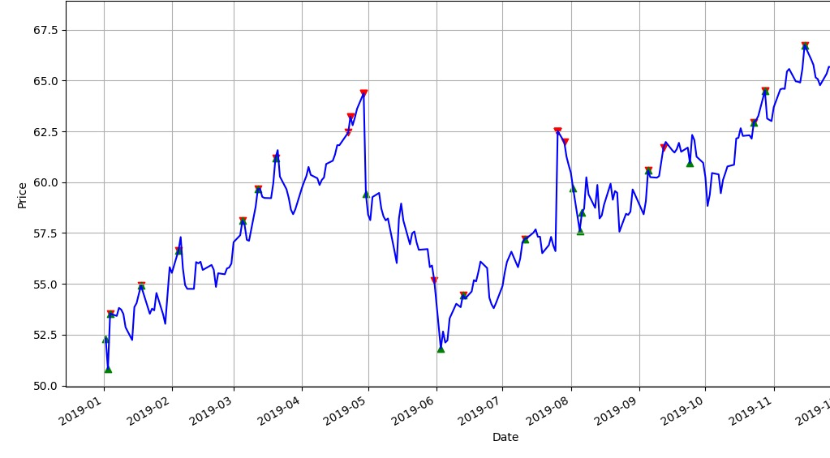
Comparison
All Features
Revenue: 1416 $
Best Features
Revenue: 3122 $

Slide 11
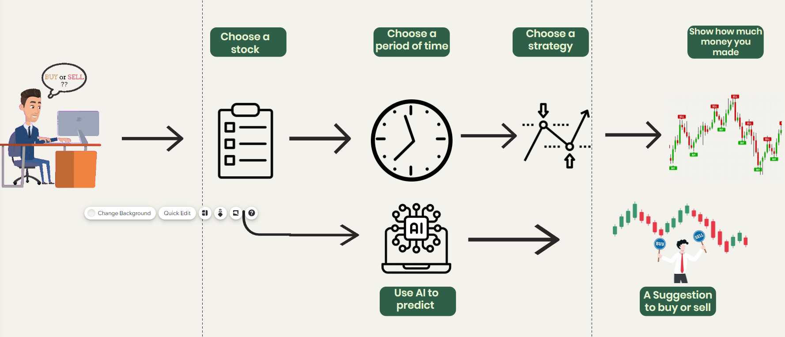
Work Process

Slide 12
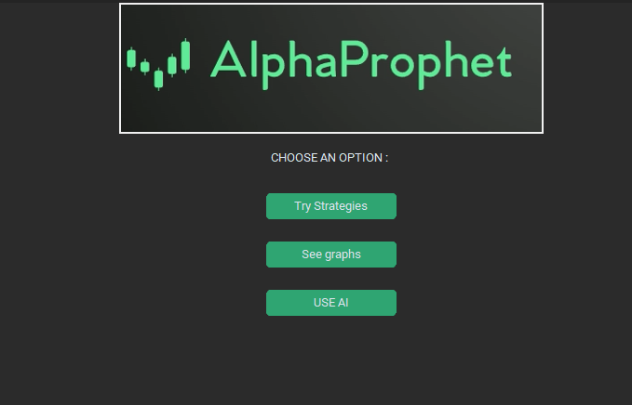
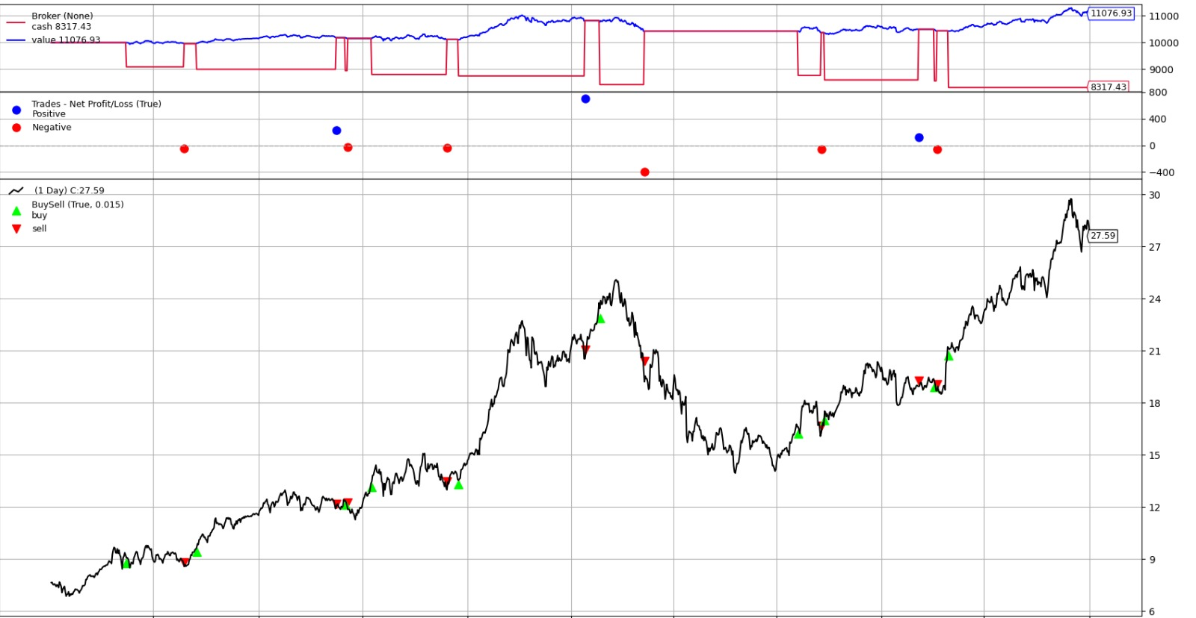
Try Strategies

Slide 13
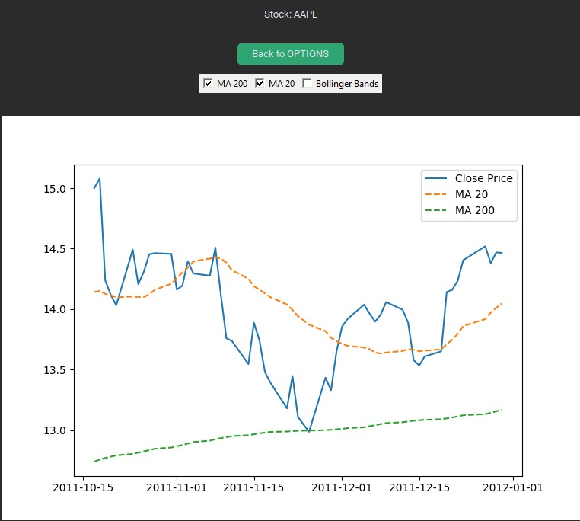
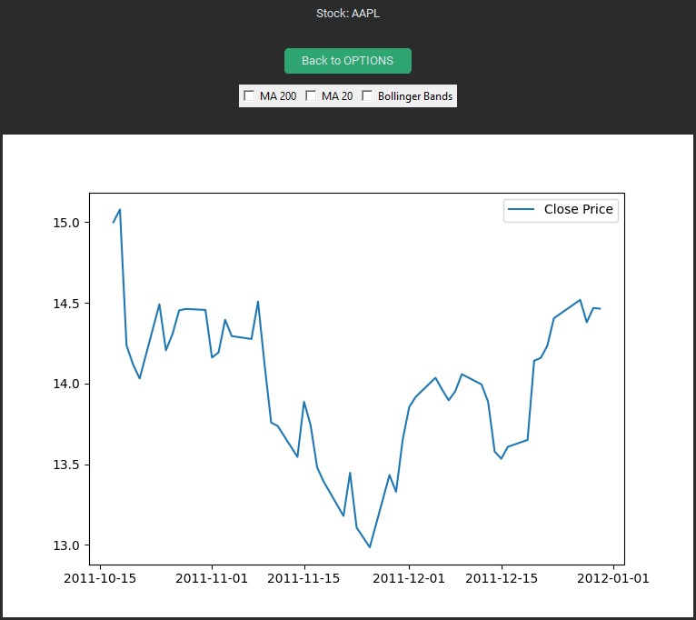
See Graph

Slide 14
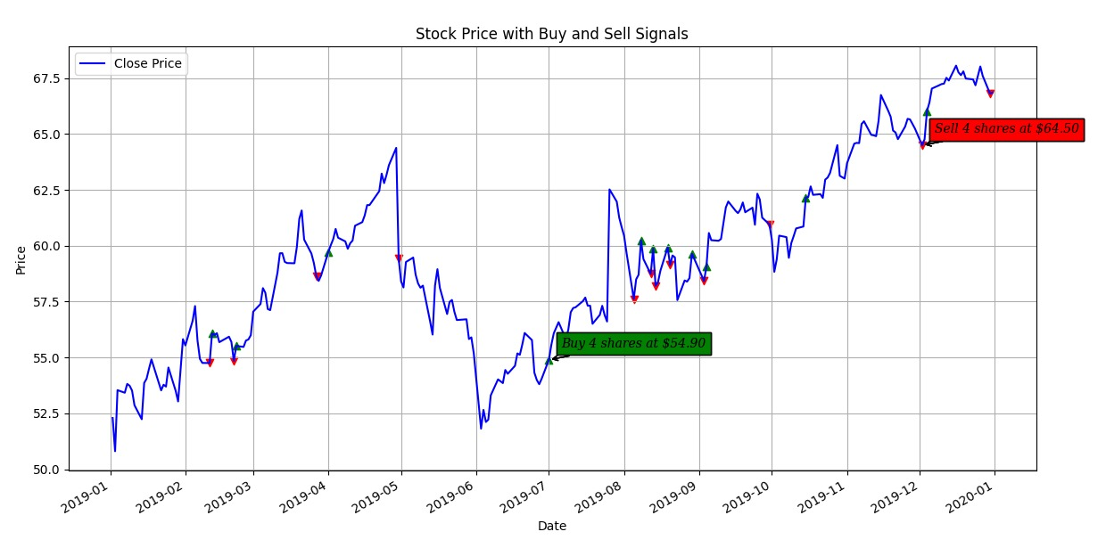
Use AI

Slide 15
What's next?
To run strategies in real time
Increase the accuracy of the predictions
Adding more data (stocks, fundamental / technical information and more)
Adding more strategies and indicators

Slide 16
THANK YOU
☺
Questions?

